Slide 1


Capstone Project
Submitted by: ALEN ANTONY
Submission type : Individual
Name: ALEN ANTONY
Batch : B1
LMS Id : alenantony30@gmail.com
Program : HDFC API DEVELOPER
Date: 27/04/2023

Slide 2

Table of contents
Introduction
Project Overview
Architecture Design
User Interface Design
Back-end Development
Testing
Deployment
Screen Shots
Conclusion
References

Slide 3
Introduction
Employee Management Application which is used for fetch the employee details from the database.
User can view employee details by using any web browser, Postman or Curl commands.

Slide 4
Project Overview
Server Application will fetch the employee details by employee id from the database and encrypt the DOB.
Client Application is using RestTemplate for calling the server application and it will decrypt the date field and display the details to the user.

Slide 5
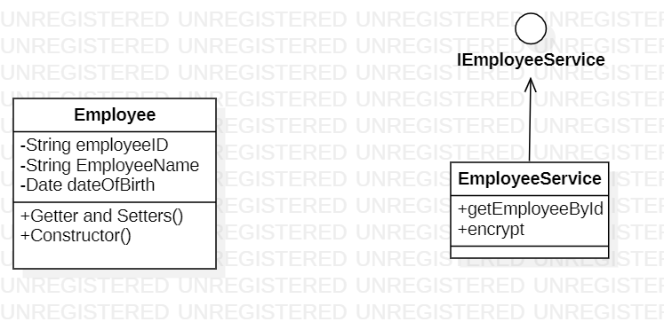
Architecture Design

Slide 6
Back-end Development
Server Application : By taking the employeeID as the input, it will fetch the data from DataBase if the employee is not found in the table it will throws an invalid employee error.
If the employee found it will encrypt the DOB and return the employee details.
It is Using a self signed file for accessing the application HTTPS.
It will logs all the details in the logs folder.

Slide 7
Back-end Development
Client Application : It takes the employeeID as Input.
Using RestTemplate it will call the server program which is running on the port number 8445.
It will decrypt the DOB field using the same key used for encryption and return the employee details.

Slide 8
Testing
Done the Unit Testing for the service layer using JUnit

Slide 9
Deployment
Created the Docker image for the server application and run the container.
Deployed the docker image using kubernates.

Slide 10
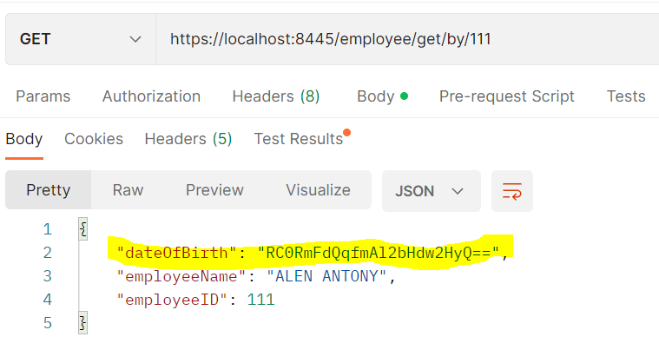
Screen Shots
Employee Server Get Request

Slide 11
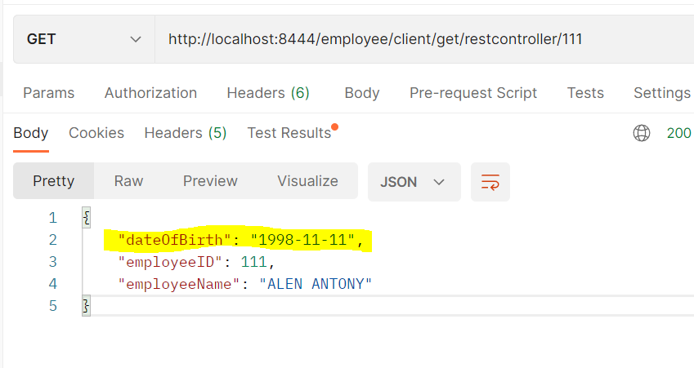
Screen Shots
Employee Client Get Request

Slide 12
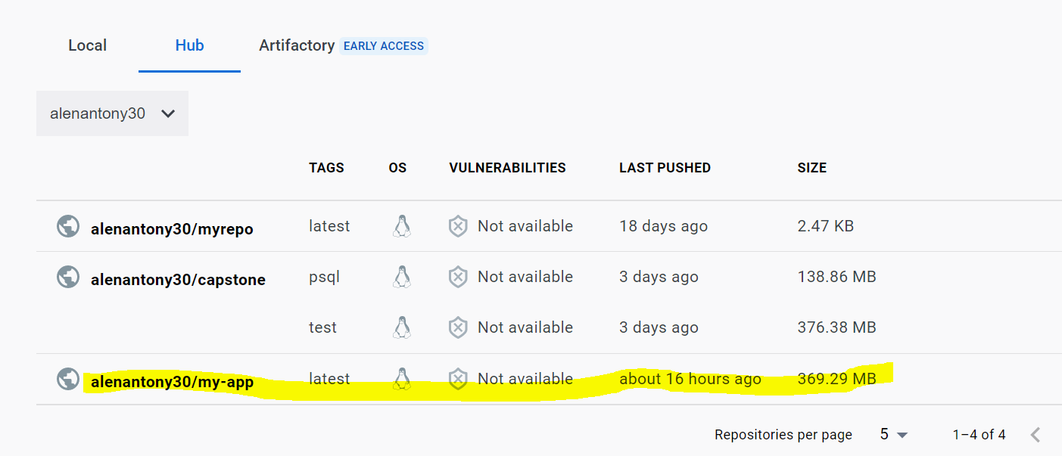
Screen Shots
Docker image

Slide 13
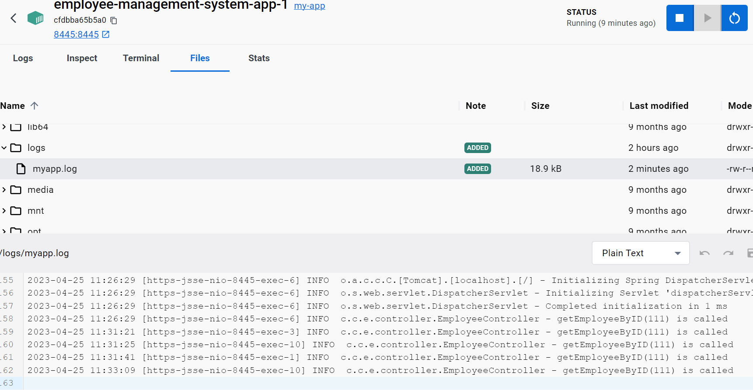
Screen Shots
Logger File

Slide 14
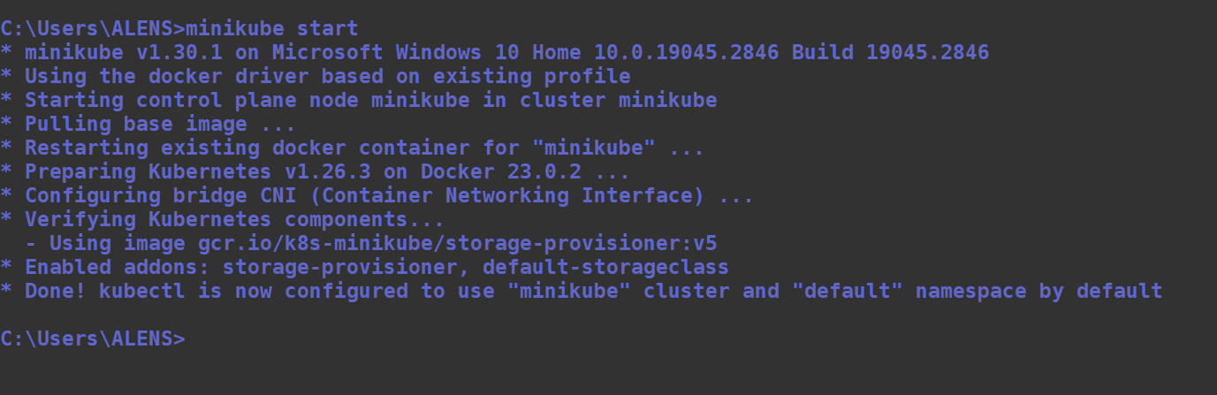
Screen Shots
Starting the minikube

Slide 15
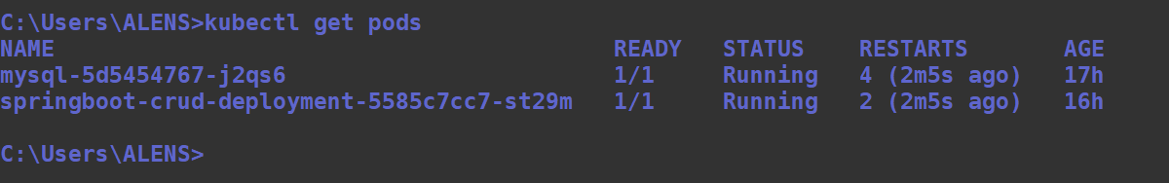
Screen Shots
Kubernates pods

Slide 16
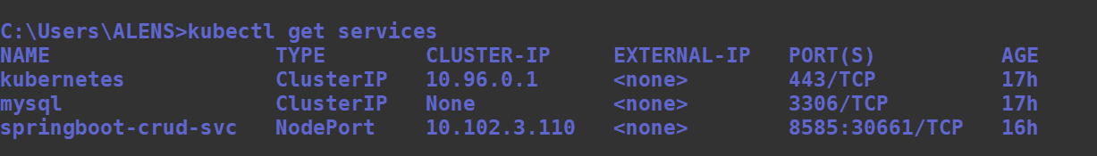
Screen Shots
Kubernates Services

Slide 17
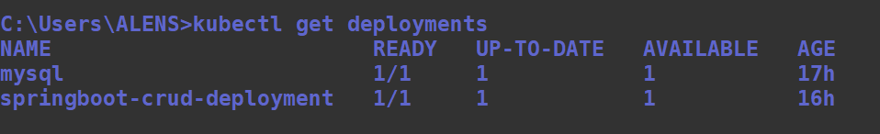
Screen Shots
Kubernates Deployment

Slide 18
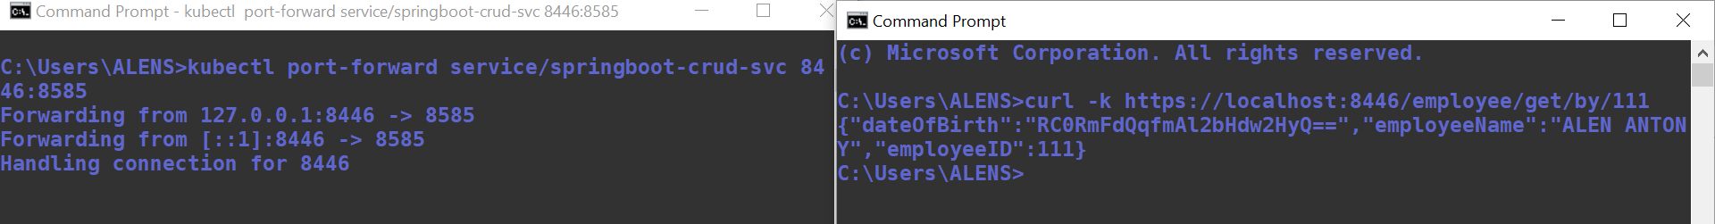
Screen Shots
CURL Commands in Kubernates pod

Slide 19
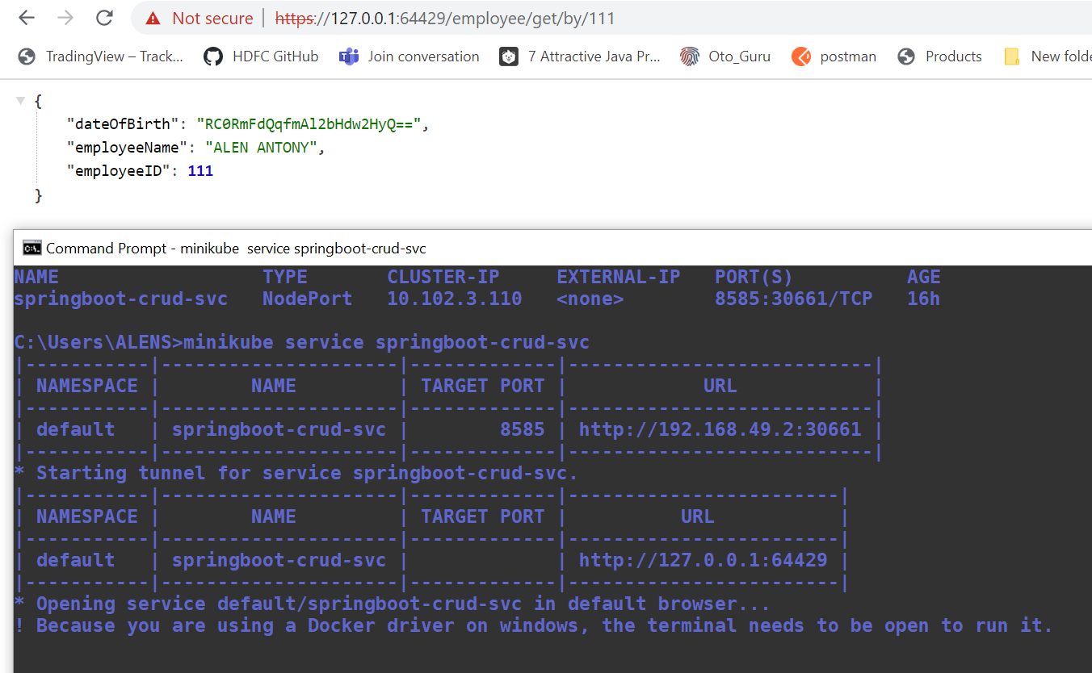
Screen Shots
Getting employee details using kubernates

Slide 20
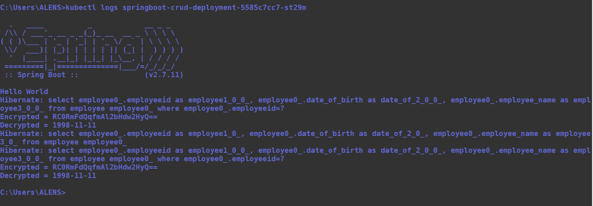
Screen Shots
Kubectl logs

Slide 21
Conclusion
Employee management client will helps to fetch the employee details with a given id and convert the details to human readable form.

Slide 22
References
Stack Overflow
Java T Point
YouTube

